Slide 1


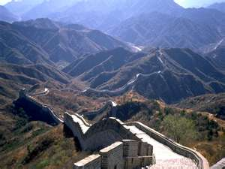

By Mr Fulton
Click
Here
China Facts
Next >

Slide 2


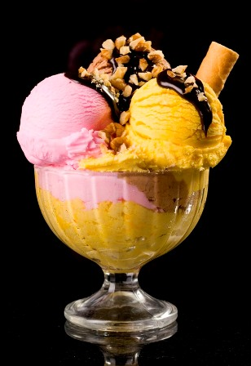
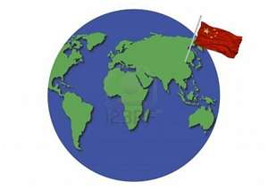

1. Ice cream was invented in China around 2000BC when the Chinese packed a soft milk and rice mixture in the snow.
2. China is the fourth largest country in the world. China is sometimes a day ahead of the United States.
3. Each year is represented by an animal. There are twelve animals which represent the twelve months.
Previous
Next >

Slide 3

1. Ice cream was invented in China around 2000BC when the Chinese packed a soft milk and rice mixture in the snow.

Slide 4
1. Ice cream was invented in China around 2000BC when the Chinese packed a soft milk and rice mixture in the snow.

Slide 5
1. Ice cream was invented in China around 2000BC when the Chinese packed a soft milk and rice mixture in the snow.

